Slide 1



Introduction to DevOps (Class: 97139) - Fall 2024
Sir Khawaja Abdul Hafeez
DEVOPS
PROJECT
Automate the installation of a MySQL database server and the creation of a user and database using Ansible.
GROUP MEMBERS:
Shaikh M. Sharjeel - 26932
Dawood Naeem - 18720
Natesh Kumar - 22983
Abdur Rehman - 24449

Slide 2


Agenda
03 | Introduction
04 | Ansible Overview
05 | Project Steps
07 | Execution and Testing
08 | Conclusion

Slide 3


03/17
01
Installing MySQL Database Server
Introduction
02
Creating a new database.
+
Automate MySQL server setup and user/database creation with Ansible.
03
Creating a new user on the newly created database.

Slide 4

04/17
Ansible Overview
Ansible is an open source configuration management and orchestration utility.
Architecture:
How?
What?
Where?
ansible.cfg
playbook.yml
inventory.yml
Global configuration file for Ansible
Sets default behaviors for modules, connections, and logging
Defines the automation tasks and their order of execution
Uses YAML syntax to describe the desired state of systems
Lists the hosts (servers or devices) to be managed
Organizes hosts into groups for easier targeting

Slide 5


Project Steps
05/17
Explaining each step in the project.
Creating EC2 Instances
Installing Ansible
Establishing Connectivity
Writing
Playbook
Created two EC2 Instances from AWS to simulate the project scenario.
Install Ansible on the Control node only.
Connectivity is ensured between the Control and DB node
Write the playbook to run tasks on the DB node.

Slide 6
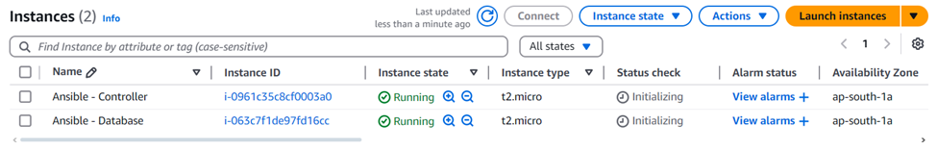
EC2 Instances
06/17
Created two EC2 Instances from AWS to simulate the project scenario.
Instance #1: Controller
The control node, which is used to run the ansible playbook
Instance #2: Database
The host node, on which the database server has to be instantiated.

Slide 7
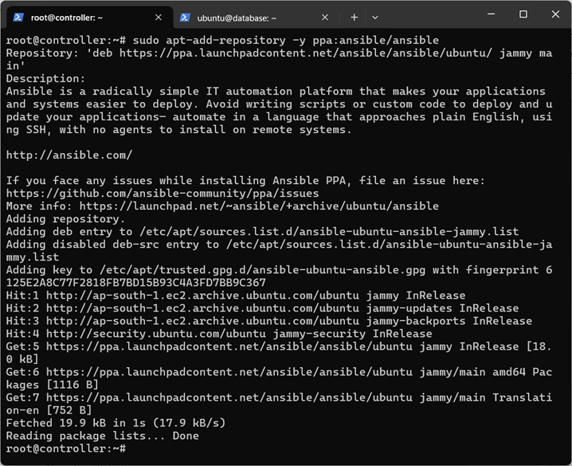
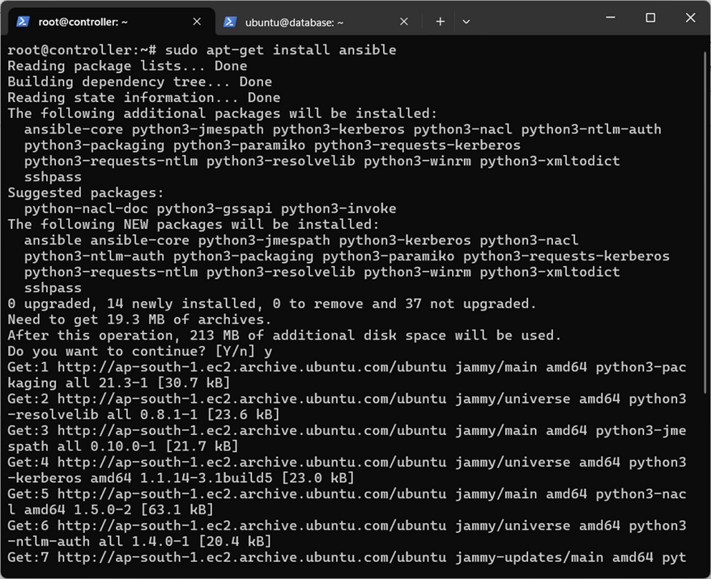
Installing Ansible
07/17
Ansible is installed - just on the control node!
1) Add Ansible PPA (Personal Package Archive)
2) Install Ansible and Verify Installation

Slide 8
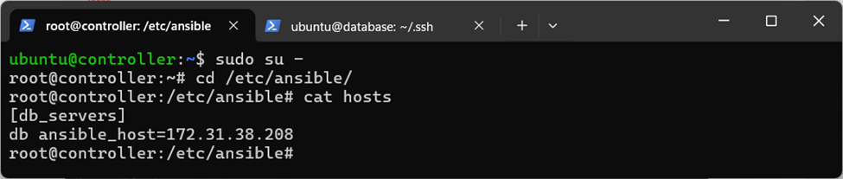
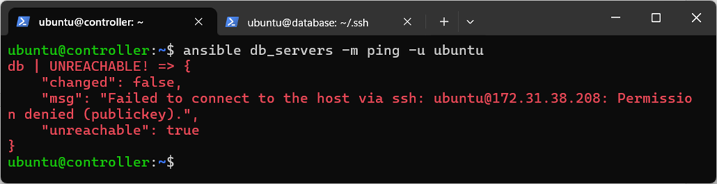
Establish Connectivity
08/17
Define db (under the context db_servers) in /etc/ansible/hosts and ping db to test if connection exists between the control and database node.
Defining IP for db (under the context db_servers) in /etc/ansible/hosts
Pinging db to test if connection exists
Connection Failed!

Slide 9
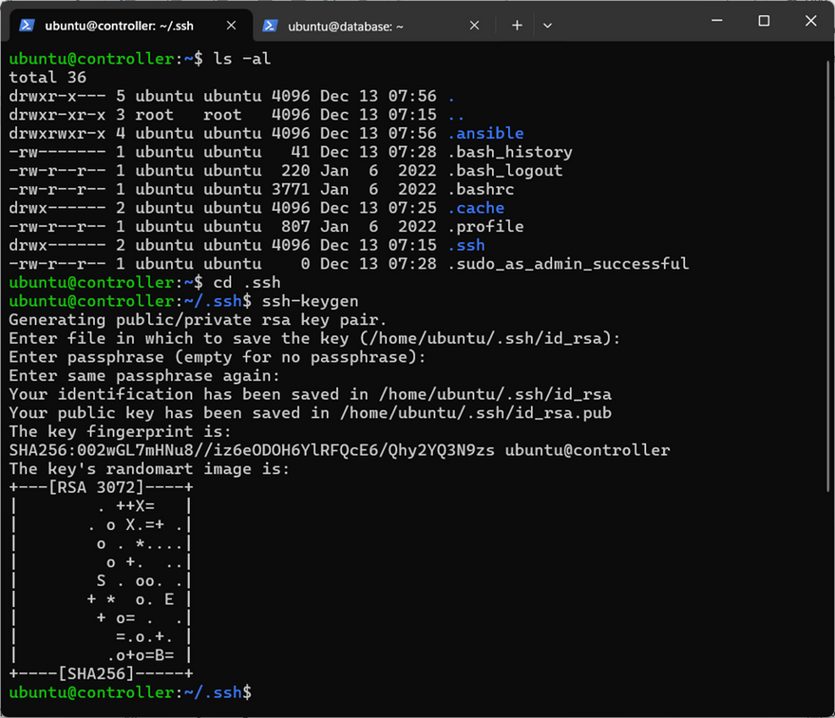
Establish Connectivity
09/17
Generating public/private rsa key pair
Connectivity is established between the two nodes by adding id_rsa.pub of the controller to the authorized_keys of the database.

Slide 10
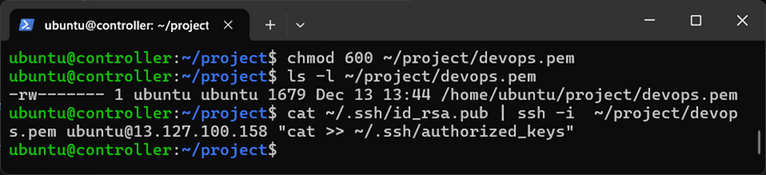
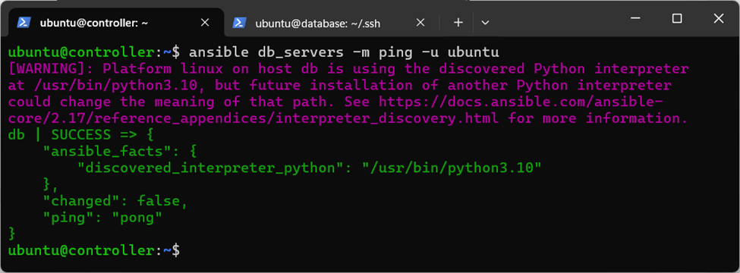
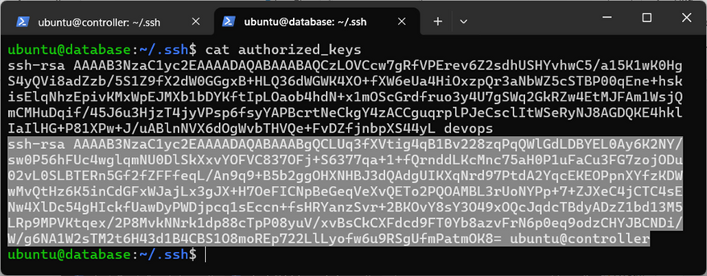
Establish Connectivity
10/17
Connectivity is established between the two nodes by adding id_rsa.pub of the controller to the authorized_keys of the database.
Copying id_rsa.pub key into authorized_keys of db
Testing connection using ansible ping
Verifying results in authorized_keys of db
Connection Successful!

Slide 11
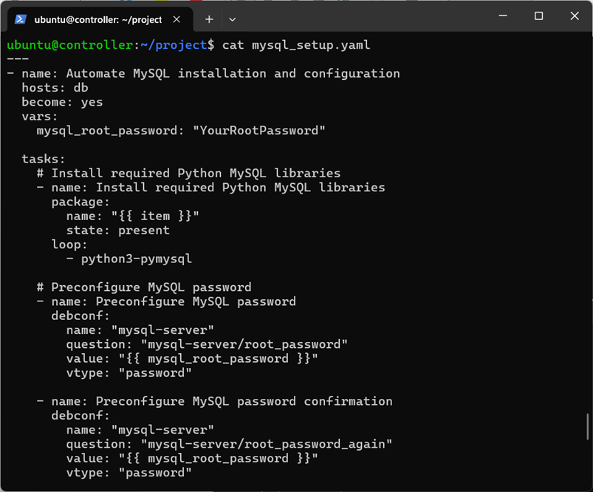
Writing Playbook
11/17
Write a playbook: mysql_setup.yaml
name: Specifies the name of the task or play.
hosts: Defines the target hosts or groups of hosts for the task or play.
become: Enables privilege escalation to execute tasks as a different user.
vars: Declares variables that can be used throughout the playbook.

Slide 12
Writing Playbook
12/17
Tasks, defined under tasks, are shown below:
Preconfigure MySQL password
Install MySQL server
Create a database
Install required Python MySQL libraries
Preconfigure MySQL password confirmation
Ensure MySQL service is running
Create a MySQL user

Slide 13

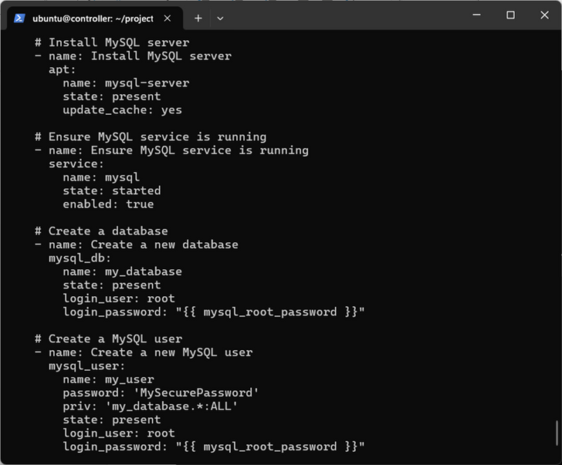

Writing Playbook
13/17
Tasks, defined under tasks, are shown below:
Task #4
Task #1
Task #5
Task #6
Task #2
Task #7
Task #3

Slide 14
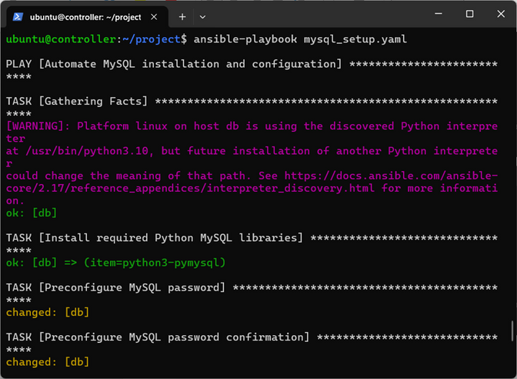
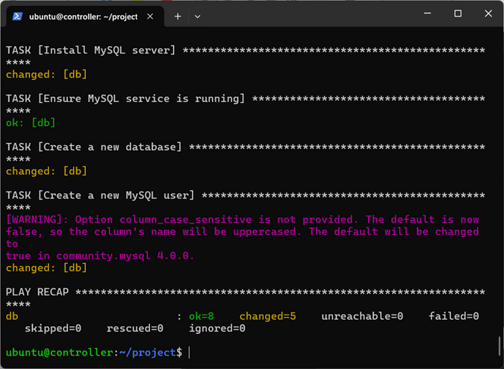
Execution & Testing
14/17
Executing the mysql_setup.yaml ansible playbook
Task #4
Initializing
Playbook
Task #5
Task #6
Task #1
Task #7
Task #2
Play Recap
Task #3

Slide 15
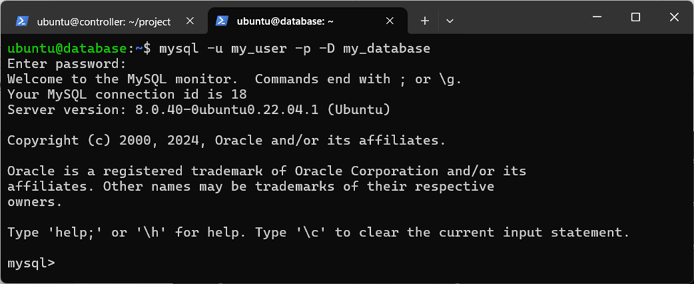
Execution & Testing
15/17
Verifying results in the database node
Log in to the MySQL server and check if the database and user exist.
Login Successful!

Slide 16
Conclusion
16/17
What We Accomplished
Automated the installation and configuration of a MySQL server using Ansible.
Pre-configured secure root access and optimized the MySQL installation process.
Created a database (my_database) and a user (my_user) with specific privileges.
Ensured consistent and repeatable deployments across systems.
Scalability and Multi-Node Setup
Using Ansible, this process can be extended to set up MySQL servers across multiple machines by simply updating the inventory file.
By defining host values in /etc/ansible/hosts on the control node, database access can be configured for multiple nodes or remote clients.

Slide 17
17/17
Thank you
GROUP MEMBERS:
Shaikh M. Sharjeel - 26932
Dawood Naeem - 18720
Natesh Kumar - 22983
Abdur Rehman - 24449

